Slide 1

Proyecto técnicas de Montecarlo: Implementación del algoritmo de búsqueda directa binaria
Presenta:
Juan Andrés González Moncada

Slide 2

Contenido
Introducción
Limitaciones de los moduladores espaciales
Hologramas binarios de amplitud
Algoritmo de búsqueda directa binaria
Implementación
Resultados
Modificación del algoritmo para control complejo
Resultados
Conclusiones
Bibliografía
Notes:
Wiki
Diferencias finitas: In numerical analysis, finite-difference methods (FDM) are a class of numerical techniques for solving differential equations by approximating derivatives with finite differences.
Finite differences were introduced by Brook Taylor in 1715 and have also been studied as abstract self-standing mathematical objects in works by George Boole (1860), L. M. Milne-Thomson (1933), and Károly Jordan [de] (1939). Finite differences trace their origins back to one of Jost Bürgi's algorithms (c. 1592) and work by others including Isaac Newton.
springer book
The finite difference method (FDM) is an approximate method for solving partial differential equations. It has been used to solve a wide range of problems. These include linear and non-linear, time independent and dependent problems. This method can be applied to problems with different boundary shapes, different kinds of boundary conditions, and for a region containing a number of different materials. Even though the method was known by such workers as Gauss and Boltzmann, it was not widely used to solve engineering problems until the 1940s. The mathematical basis of the method was already known to Richardson in 1910 [1] and many mathematical books such as references [2 and 3] were published which discussed the finite difference method. Specific reference concerning the treatment of electric and magnetic field problems is made in [4]. The application of FDM is not difficult as it involves only simple arithmetic in the derivation of the discretization equations and in writing the corresponding programs. During 1950-1970 FDM was the most important numerical method used to solve practical problems ([5-7]). With the development of high speed computers having large scale storage capability many numerical solution techniques appeared for solving partial differential equations. However, due to the ease of application of the finite difference method it is still a valuable means of solving these problems ([8-11]). Similar to other numerical methods, the aim of finite difference is to replace a continuous field problem with infinite degrees of freedom by a discretized field with finite regular nodes. The partial derivatives of the unknown function are approximated by the difference quotients at a set offinite discretization points. The original partial differential equation is then transformed in to a set of algebraic equations. The solution of these simultaneous equations is the approximate solution of the original boundary value problem.

Slide 3
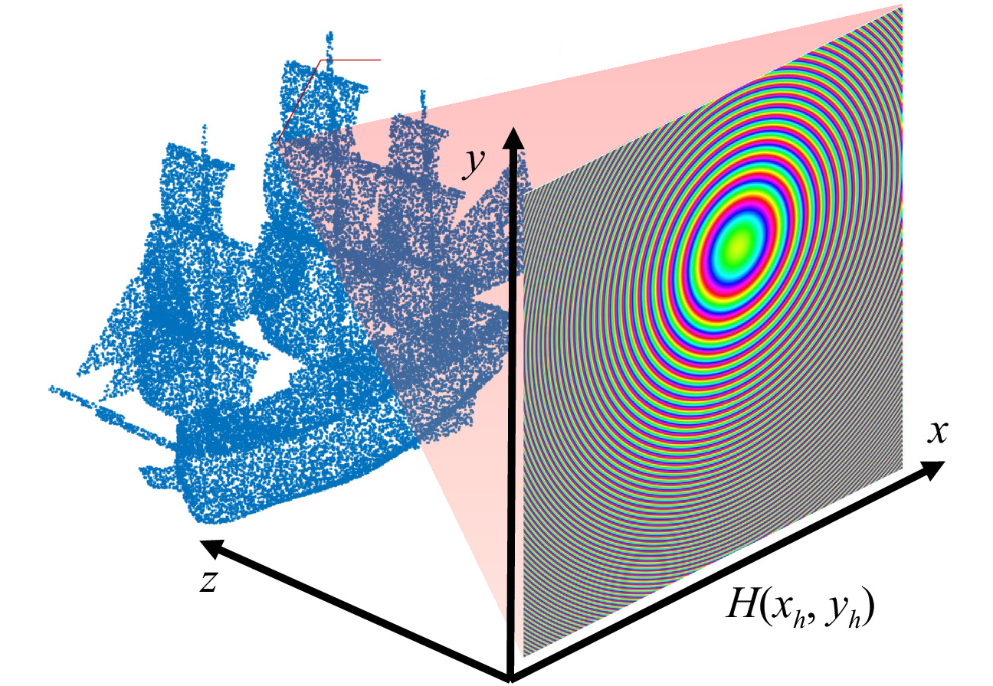
Introducción
La holografía generada por computadora es una técnica que ha despertado gran interés por su capacidad de controlar campos ópticos con una precisión excepcional.
Fig 1. Esquema de display 3D mediante holografía generada por computadora. [1]
[1] D. Blinder et al, “The state-of-the-art in computer generated holography for 3D display”, (2022)
Notes:
Wiki
Diferencias finitas: In numerical analysis, finite-difference methods (FDM) are a class of numerical techniques for solving differential equations by approximating derivatives with finite differences.
Finite differences were introduced by Brook Taylor in 1715 and have also been studied as abstract self-standing mathematical objects in works by George Boole (1860), L. M. Milne-Thomson (1933), and Károly Jordan [de] (1939). Finite differences trace their origins back to one of Jost Bürgi's algorithms (c. 1592) and work by others including Isaac Newton.
springer book
The finite difference method (FDM) is an approximate method for solving partial differential equations. It has been used to solve a wide range of problems. These include linear and non-linear, time independent and dependent problems. This method can be applied to problems with different boundary shapes, different kinds of boundary conditions, and for a region containing a number of different materials. Even though the method was known by such workers as Gauss and Boltzmann, it was not widely used to solve engineering problems until the 1940s. The mathematical basis of the method was already known to Richardson in 1910 [1] and many mathematical books such as references [2 and 3] were published which discussed the finite difference method. Specific reference concerning the treatment of electric and magnetic field problems is made in [4]. The application of FDM is not difficult as it involves only simple arithmetic in the derivation of the discretization equations and in writing the corresponding programs. During 1950-1970 FDM was the most important numerical method used to solve practical problems ([5-7]). With the development of high speed computers having large scale storage capability many numerical solution techniques appeared for solving partial differential equations. However, due to the ease of application of the finite difference method it is still a valuable means of solving these problems ([8-11]). Similar to other numerical methods, the aim of finite difference is to replace a continuous field problem with infinite degrees of freedom by a discretized field with finite regular nodes. The partial derivatives of the unknown function are approximated by the difference quotients at a set offinite discretization points. The original partial differential equation is then transformed in to a set of algebraic equations. The solution of these simultaneous equations is the approximate solution of the original boundary value problem.

Slide 4
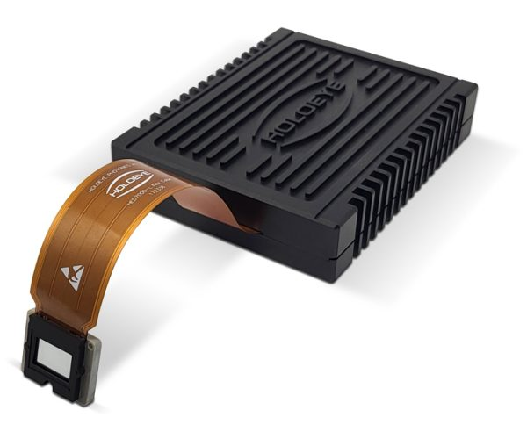
Limitación de los moduladores espaciales de luz
Los moduladores espaciales de luz son incapaces de reproducir directamente los hologramas complejos generados.
Fig 2. Modulador espacial de solo fase. Tomado de [2]
[2] Holoeye, Modulador Gaea-2.
Notes:
Wiki
Diferencias finitas: In numerical analysis, finite-difference methods (FDM) are a class of numerical techniques for solving differential equations by approximating derivatives with finite differences.
Finite differences were introduced by Brook Taylor in 1715 and have also been studied as abstract self-standing mathematical objects in works by George Boole (1860), L. M. Milne-Thomson (1933), and Károly Jordan [de] (1939). Finite differences trace their origins back to one of Jost Bürgi's algorithms (c. 1592) and work by others including Isaac Newton.
springer book
The finite difference method (FDM) is an approximate method for solving partial differential equations. It has been used to solve a wide range of problems. These include linear and non-linear, time independent and dependent problems. This method can be applied to problems with different boundary shapes, different kinds of boundary conditions, and for a region containing a number of different materials. Even though the method was known by such workers as Gauss and Boltzmann, it was not widely used to solve engineering problems until the 1940s. The mathematical basis of the method was already known to Richardson in 1910 [1] and many mathematical books such as references [2 and 3] were published which discussed the finite difference method. Specific reference concerning the treatment of electric and magnetic field problems is made in [4]. The application of FDM is not difficult as it involves only simple arithmetic in the derivation of the discretization equations and in writing the corresponding programs. During 1950-1970 FDM was the most important numerical method used to solve practical problems ([5-7]). With the development of high speed computers having large scale storage capability many numerical solution techniques appeared for solving partial differential equations. However, due to the ease of application of the finite difference method it is still a valuable means of solving these problems ([8-11]). Similar to other numerical methods, the aim of finite difference is to replace a continuous field problem with infinite degrees of freedom by a discretized field with finite regular nodes. The partial derivatives of the unknown function are approximated by the difference quotients at a set offinite discretization points. The original partial differential equation is then transformed in to a set of algebraic equations. The solution of these simultaneous equations is the approximate solution of the original boundary value problem.

Slide 5
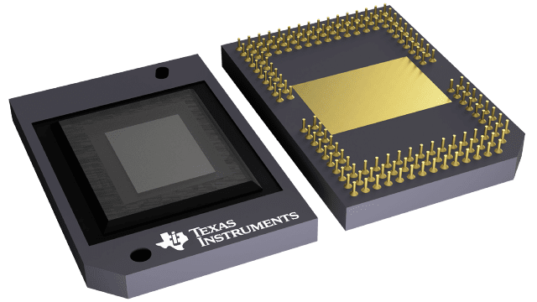
Hologramas binarios de amplitud
Entre los moduladores disponibles, los dispositivos digitales de microespejos son moduladores binarios de amplitud que destacan por su bajo precio y alta tasa de refresco.
Fig 3. Dispositivo digital de microespejos. Tomado de [3]
[3] Texas Instruments, Dispositivo digital de microespejos DLP550JEFYA.
Notes:
Wiki
Diferencias finitas: In numerical analysis, finite-difference methods (FDM) are a class of numerical techniques for solving differential equations by approximating derivatives with finite differences.
Finite differences were introduced by Brook Taylor in 1715 and have also been studied as abstract self-standing mathematical objects in works by George Boole (1860), L. M. Milne-Thomson (1933), and Károly Jordan [de] (1939). Finite differences trace their origins back to one of Jost Bürgi's algorithms (c. 1592) and work by others including Isaac Newton.
springer book
The finite difference method (FDM) is an approximate method for solving partial differential equations. It has been used to solve a wide range of problems. These include linear and non-linear, time independent and dependent problems. This method can be applied to problems with different boundary shapes, different kinds of boundary conditions, and for a region containing a number of different materials. Even though the method was known by such workers as Gauss and Boltzmann, it was not widely used to solve engineering problems until the 1940s. The mathematical basis of the method was already known to Richardson in 1910 [1] and many mathematical books such as references [2 and 3] were published which discussed the finite difference method. Specific reference concerning the treatment of electric and magnetic field problems is made in [4]. The application of FDM is not difficult as it involves only simple arithmetic in the derivation of the discretization equations and in writing the corresponding programs. During 1950-1970 FDM was the most important numerical method used to solve practical problems ([5-7]). With the development of high speed computers having large scale storage capability many numerical solution techniques appeared for solving partial differential equations. However, due to the ease of application of the finite difference method it is still a valuable means of solving these problems ([8-11]). Similar to other numerical methods, the aim of finite difference is to replace a continuous field problem with infinite degrees of freedom by a discretized field with finite regular nodes. The partial derivatives of the unknown function are approximated by the difference quotients at a set offinite discretization points. The original partial differential equation is then transformed in to a set of algebraic equations. The solution of these simultaneous equations is the approximate solution of the original boundary value problem.

Slide 6
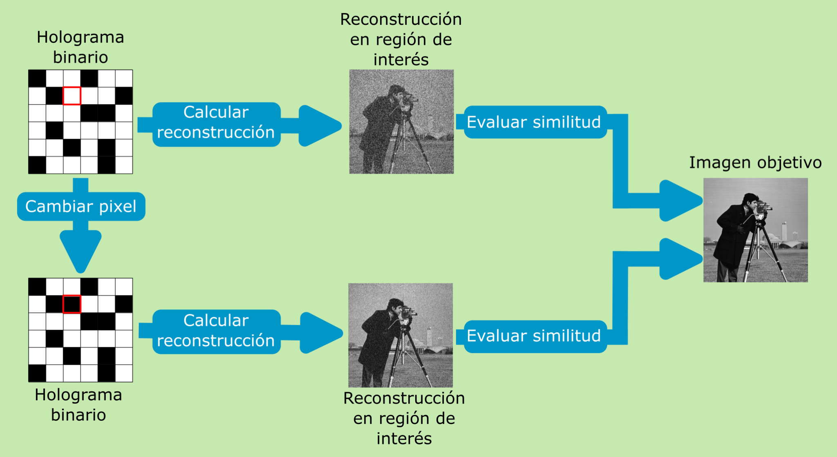
Algoritmo de búsqueda directa binaria
Fig 4. Diagrama de flujo de algoritmo de búsqueda directa binaria.
[4] M. Seldowitz, J. P. Allebach, y D. W. Sweeney, "Synthesis of digital holograms by direct binary search," (1987)
Notes:
prevailing consensus is that Galileo Galilei made the first attempts at developing a theory of beams, but recent studies argue that Leonardo da Vinci was the first to make the crucial observations. Da Vinci lacked Hooke's law and calculus to complete the theory, whereas Galileo was held back by an incorrect assumption he made.^{[3]}
The Bernoulli beam is named after Jacob Bernoulli, who made the significant discoveries. Leonhard Euler and Daniel Bernoulli were the first to put together a useful theory circa 1750.^{[4]}
deflexión de una viga de sección transversal rectangular sujeta a una carga uniforme mientras los extremos de la viga están apoyados de modo que no sufran deflexión.

Slide 7
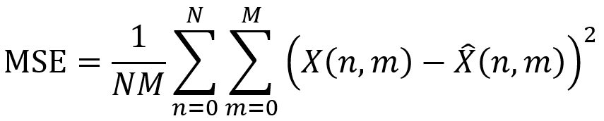
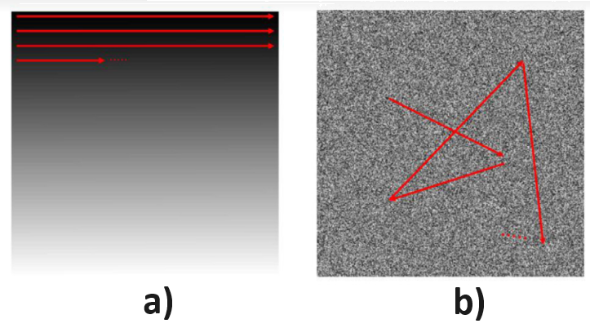
Implementación
Utilizamos el error cuadrático medio
Analizamos cada píxel del holograma en orden lexicográfico y aleatorio
Fig 5. a) Orden lexicográfico. b) Orden aleatorio. Tomado de [5]
[5] J. H. Kang, et al “Non-iterative direct binary search algorithm for fast generation of binary holograms”, (2019)
Notes:
prevailing consensus is that Galileo Galilei made the first attempts at developing a theory of beams, but recent studies argue that Leonardo da Vinci was the first to make the crucial observations. Da Vinci lacked Hooke's law and calculus to complete the theory, whereas Galileo was held back by an incorrect assumption he made.^{[3]}
The Bernoulli beam is named after Jacob Bernoulli, who made the significant discoveries. Leonhard Euler and Daniel Bernoulli were the first to put together a useful theory circa 1750.^{[4]}
deflexión de una viga de sección transversal rectangular sujeta a una carga uniforme mientras los extremos de la viga están apoyados de modo que no sufran deflexión.

Slide 8
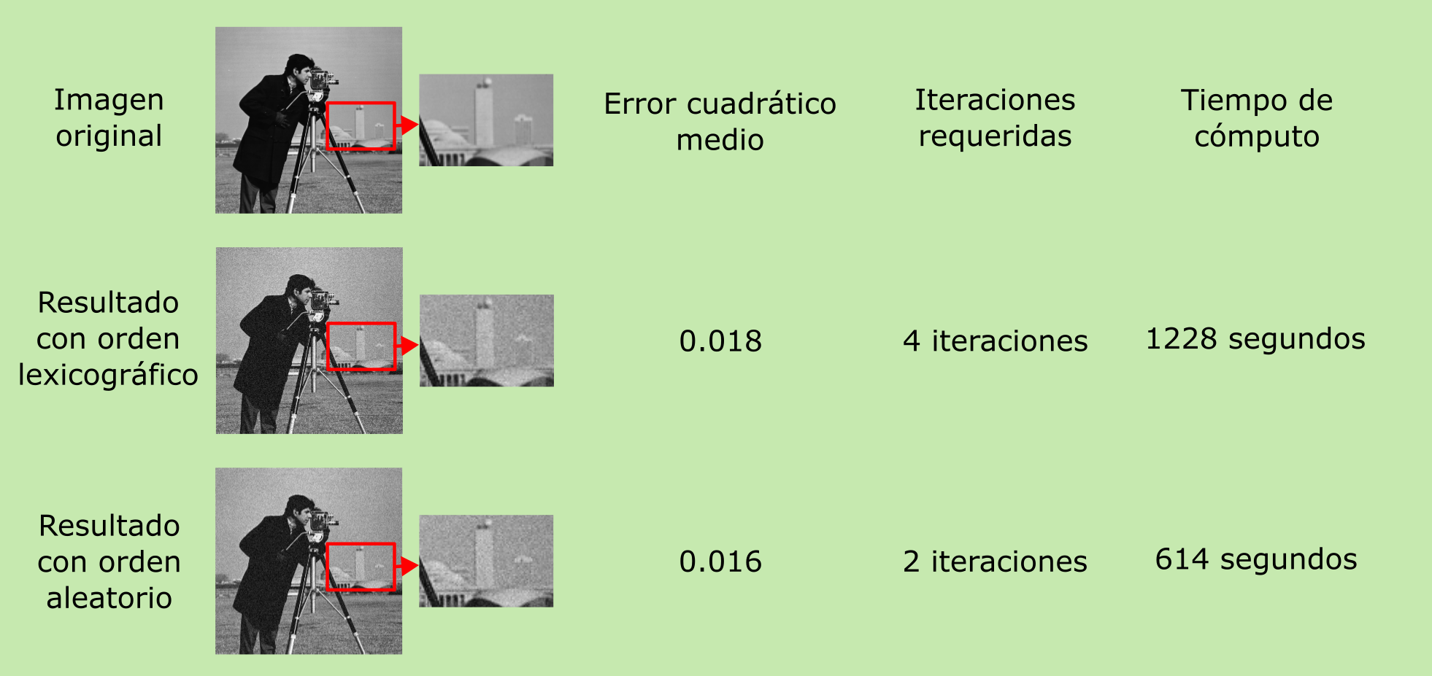
Resultados
Fig 6. Resultados obtenidos aplicando el algoritmo con ambos órdenes de evaluación de píxeles.
Notes:
prevailing consensus is that Galileo Galilei made the first attempts at developing a theory of beams, but recent studies argue that Leonardo da Vinci was the first to make the crucial observations. Da Vinci lacked Hooke's law and calculus to complete the theory, whereas Galileo was held back by an incorrect assumption he made.^{[3]}
The Bernoulli beam is named after Jacob Bernoulli, who made the significant discoveries. Leonhard Euler and Daniel Bernoulli were the first to put together a useful theory circa 1750.^{[4]}
deflexión de una viga de sección transversal rectangular sujeta a una carga uniforme mientras los extremos de la viga están apoyados de modo que no sufran deflexión.

Slide 9
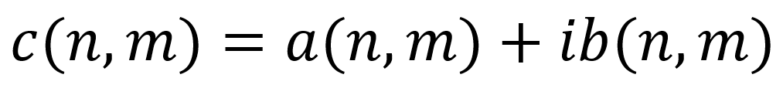
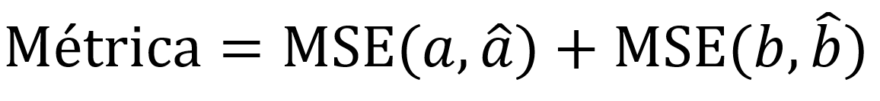
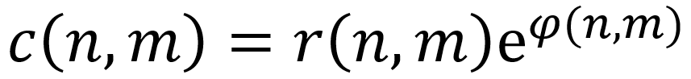


Modificación para control complejo
Notes:
The Duffing equation (or Duffing oscillator), named after Georg Duffing (1861–1944), is a non-linear second-order differential equation used to model certain damped and driven oscillators. The equation is given by

Slide 10
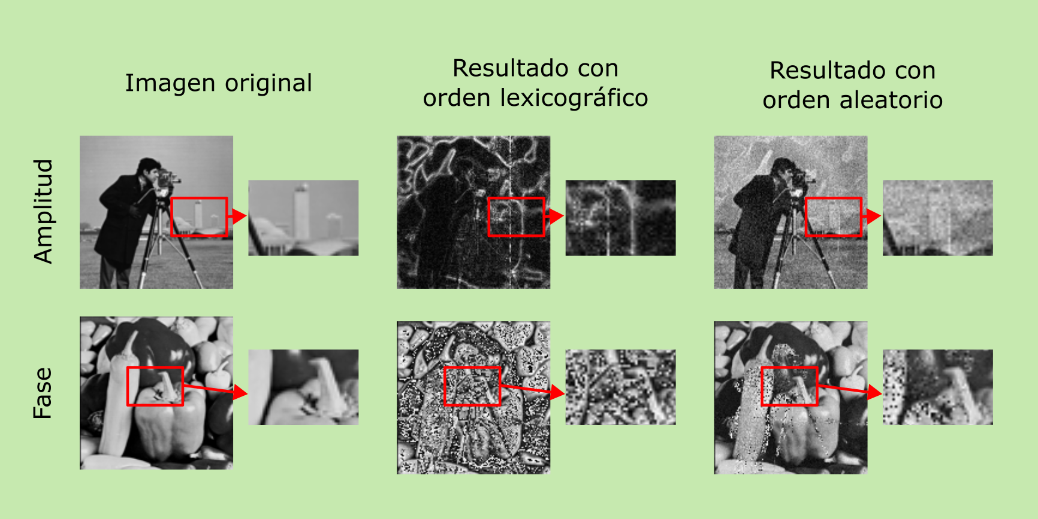
Resultados
Fig 7. Resultados obtenidos aplicando el algoritmo modificado con ambos órdenes de evaluación de píxeles.
Notes:
The Duffing equation (or Duffing oscillator), named after Georg Duffing (1861–1944), is a non-linear second-order differential equation used to model certain damped and driven oscillators. The equation is given by

Slide 11
Conclusiones
Se implementa el algoritmo de búsqueda directa binaria tradicional y se mejora su tasa de convergencia introduciendo escaneo aleatorio.
Se propone una modificación del algoritmo de búsqueda directa binaria que permite el control complejo del campo reconstruido y se demuestra su efectividad con simulaciones numéricas.
La velocidad del algoritmo se podría reducir en mayor medida implementando modificaciones que permitan introducir procesamiento paralelo o entrenando redes neuronales para generar hologramas binarios.
Notes:
The Duffing equation (or Duffing oscillator), named after Georg Duffing (1861–1944), is a non-linear second-order differential equation used to model certain damped and driven oscillators. The equation is given by

Slide 12
Bibliografía:
[1] Blinder, D., Birnbaum, T., Ito, T., & Shimobaba, T. (2022). The state-of-the-art in computer generated holography for 3D display. Light: Advanced Manufacturing, 3(3), 572-600.
[2] Holoeye, Modulador Gaea-2. Recuperado el 18/03/2024 de https://holoeye.com/products/spatial-light-modulators/gaea-2-phase-only/
[3] Texas Instruments, Dispositivo digital de microespejos DLP550JEFYA. Recuperado el 18/03/2024 de https://www.ti.com/product/DLP550JE/part-details/DLP550JEFYA
[4] Seldowitz, M. A., Allebach, J. P., & Sweeney, D. W. (1987). Synthesis of digital holograms by direct binary search. Applied optics, 26(14), 2788-2798.
[5] Kang, J. H., Leportier, T., Kim, M., & Park, M. C. (2019). Non-iterative direct binary search algorithm for fast generation of binary holograms. Optics and Lasers in Engineering, 122, 312-318.
Notes:
prevailing consensus is that Galileo Galilei made the first attempts at developing a theory of beams, but recent studies argue that Leonardo da Vinci was the first to make the crucial observations. Da Vinci lacked Hooke's law and calculus to complete the theory, whereas Galileo was held back by an incorrect assumption he made.^{[3]}
The Bernoulli beam is named after Jacob Bernoulli, who made the significant discoveries. Leonhard Euler and Daniel Bernoulli were the first to put together a useful theory circa 1750.^{[4]}
deflexión de una viga de sección transversal rectangular sujeta a una carga uniforme mientras los extremos de la viga están apoyados de modo que no sufran deflexión.

Slide 13


